Slide 1
COMPONENT DIAGRAM in UML 2.0

Slide 2
Topics
Introduction about components
Components and component diagrams in uml 2.0
Case study
Elements of the component
Component view: black-box view and white-box view
Deployment diagrams

Slide 3
INTRODUCTION
UML component diagrams describe software components and their dependencies to each others
  A component is an autonomous unit within a system
  The components can be used to define software systems of arbitrary size and complexity
  UML component diagrams enable to model the high-level software components, and the interfaces to those components
  Important for component-based development (CBD)
  Component and subsystems can be flexibly REUSED and REPLACED
  A dependency exists between two elements if changes to the definition of one element may cause changes to the other
  Component Diagrams are often referred to as “wiring diagrams”
  The wiring of components can be represented on diagrams by means of components and dependencies between them

Slide 4
INTRODUCTION
An Uml diagram classification:
Static
  Use case diagram, Class diagram
Dynamic
  State diagram, Activity diagram, Sequence diagram, Collaboration diagram
Implementation
  Component diagram, Deployment diagram
UML components diagrams are
Implementation diagrams: describe the different elements required for implementing a system

Slide 5
INTRODUCTION
Another classification:
Behavior diagrams
  A type of diagram that depicts behavior of a system
  This includes activity, state machine, and use case diagrams, interaction diagrams
Interaction diagrams
  A subset of behavior diagrams which emphasize object interactions. This includes collaboration, activity, sequence diagrams
Structure diagrams
  A type of diagram that depicts the elements of a specification that are irrespective of time. This includes class, composite structure, component, deployment
UML components diagrams are structure diagrams

Slide 6
COMPONENT in UML 2.0
Modular unit with well-defined interfaces that is replaceable within its environment
Autonomous unit within a system
  Has one or more provided and required interfaces
  Its internals are hidden and inaccessible
  A component is encapsulated
  Its dependencies are designed such that it can be treated as independently as possible

Slide 7
CASE STUDY
Development of an application collecting students’ opinions about courses
A student can
  Read
  Insert
  Update
  Make data permanent about the courses in its schedule
A professor can only see statistic elaboration of the data
The student application must be installed in pc client (sw1, sw2)
The manager application must be installed in pc client (in the manager’s office)
There is one or more servers with DataBase and components for courses management

Slide 8


COMPONENT NOTATION
A component is shown as a rectangle with
  A keyword <<component>>
  Optionally, in the right hand corner a component icon can be displayed
    A component icon is a rectangle with two smaller rectangles jutting out from the left-hand side
    This symbol is a visual stereotype
  The component name
Components can be labelled with a stereotype
there are a number of standard stereotypes ex: <<entity>>, <<subsystem>>

Slide 9
Component ELEMENTS
A component can have
  Interfaces
    An interface represents a declaration of a set of
    operations and obligations
  Usage dependencies
    A usage dependency is relationship which one element
    requires another element for its full implementation
  Ports
    Port represents an interaction point between a component
    and its environment
  Connectors
    Connect two components
    Connect the external contract of a component to the internal structure

Slide 10
INTERFACE
A component defines its behaviour in terms of provided and required interfaces
An interface
  Is the definition of a collection of one or more operations
  Provides only the operations but not the implementation
  Implementation is normally provided by a class/ component
  In complex systems, the physical implementation is provided by a group of classes rather than a single class

Slide 11
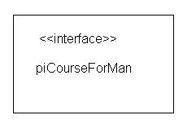
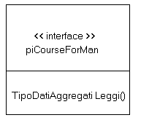
INTERFACE
May be shown using a rectangle symbol with a keyword <<interface>> preceding the name
For displaying the full signature, the interface rectangle can be expanded to show details
Can be
  Provided
  Required

Slide 12


INTERFACE
A provided interface
  Characterize services that the component offers to its environment
  Is modeled using a ball, labelled with the name, attached by a solid line to the component
A required interface
  Characterize services that the component expects from its environment
  Is modeled using a socket, labelled with the name, attached by a solid line to the component
  In UML 1.x were modeled using a dashed arrow

Slide 13


INTERFACE
Where two components/classes provide and require the same interface, these two notations may be combined
The ball-and-socket notation hint at that interface in question serves to mediate interactions between the two components
If an interface is shown using the rectangle symbol, we can use an alternative notation, using dependency arrows

Slide 14
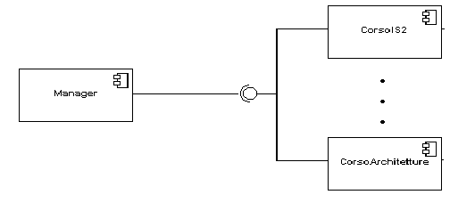
INTERFACE
In a system context where there are multiple components that require or provide a particular interface, a notation abstraction can be used that combines by joining
the interfaces
A component
  Specifies a CONTRACT of the services that it provides to its clients and that it requires from others components in terms of its provided and required interfaces
  Can be replaced
  The system can be extended

Slide 15

DEPENDENCIES
Components can be connected by usage dependencies
Usage Dependency
  A usage dependency is relationship which one element requires another element for its full implementation
  Is a dependency in which the client requires the presence of the supplier
  Is shown as dashed arrow with a <<use>> keyword
  The arrowhead point from the dependent component to the one of which it is dependent

Slide 16
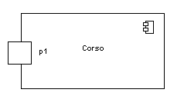
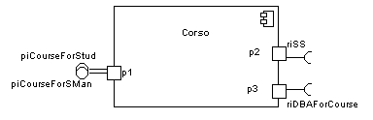
PORT
Specifies a distinct interaction point
  Between that component and its environment
  Between that component and its internal parts
Is shown as a small square symbol
Ports can be named, and the name is placed near the square symbol
Is associated with the interfaces that specify the nature of the interactions that may occur over a port

Slide 17

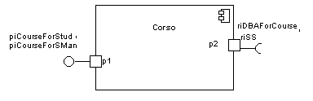
PORT
Ports can support unidirectional communication or bi-directional communication
If there are multiple interfaces associated with a port, these interfaces may be listed with the interface icon, separated by a commas

Slide 18
PORT
  All interactions of a component with its environment are achieved through a port
  The internals are fully isolated from the environment
  This allows such a component to be used in any context that satisfies the constraints specified by its ports
  Ports are not defined in UML 1.x

Slide 19

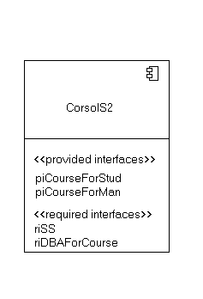
EXTERNAL VIEW
A component have an external view and an internal view
An external view (or black box view) shows publicly visible properties and operations
An external view of a component is by means of interface symbols sticking out of the component box
The interface can be listed in the compartment of a component box

Slide 20
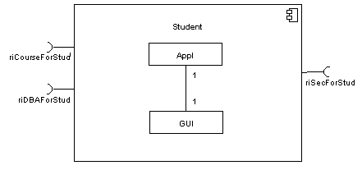
INTERNAL VIEW
An internal, or white box view of a component is where the realizing classes/components are nested within the component shape
Realization is a relationship between two set of model elements
  One represents a specification
  The other represent an implementation of the latter

Slide 21
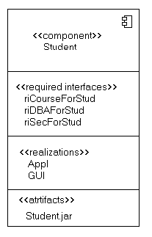
INTERNAL VIEW
The internal class that realize the behavior of a component may be displayed in an additional compartment
Compartments can also be used to display parts, connectors or implementation artifacts
An artifact is the specification of a phisycal piece of information

Slide 22
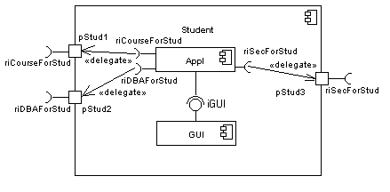
INTERNAL VIEW
Components can be built recursively

Slide 23

ASSEMBLY
Two kinds of connectors:
  Delegation
  Assembly
ASSEMBLY CONNECTOR
  A connector between 2 components defines that one component provides the services that another component requires
  He must only be defined from a required interface to a provided interface
  An assembly connector is notated by a “ball-and-socket” connection
  This notation allows for succint grafical
  wiring of components

Slide 24
SEMANTICS
The semantics for an assembly connector :
  Are that signals travel along an instance of a connector originating in a required port and delivered to a provided port
  The interfaces provided and required must be compatible
  The interface compatibility between provided and required ports that are connected enables an existing component in a system to be replaced

Slide 25
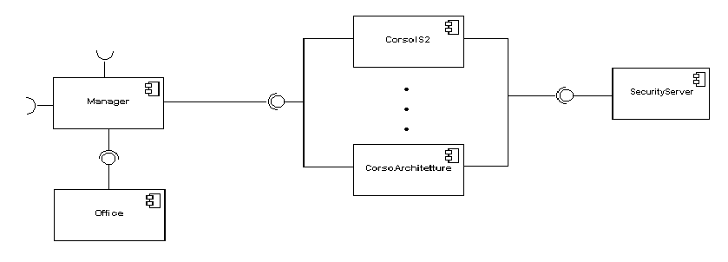
SEMANTICS
  Multiple connections directed from a single required interface to provided interfaces indicates that the instance that will handle the signal will be determined at execution time

Slide 26
DELEGATION
DELEGATION CONNECTOR
  Links the external contract of a component to the internal realization
  Represents the forwarding of signals
  He must only be defined between used interfaces or ports of the same kind

Slide 27
DELEGATION
  The target interface must support a signature compatible with a subset of operations of the source interface
  A port may delegate to a set of ports on subordinate components
  The union of the target interfaces must be signature compatible with the source interface
Semantics:
  Is a declaration that behaviour that is available on a component instance is not realized by that component itself, but by another instance that has compatible capabilities
  Is used to model the hierarchical decomposition
  Message and signal flow will occur between the connected ports

Slide 28
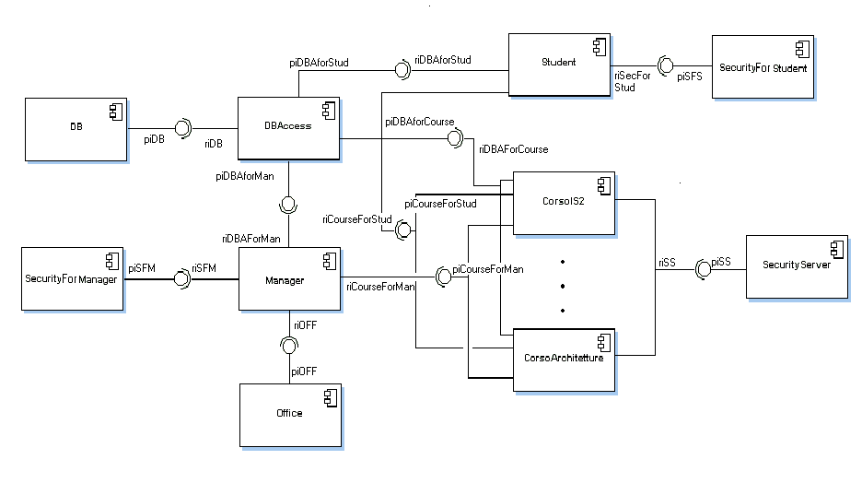
CASE STUDY

Slide 29
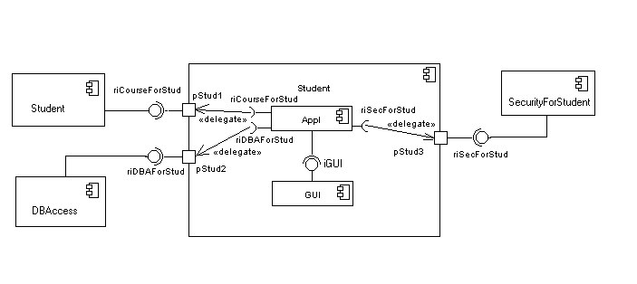
CASE STUDY

Slide 30
DEPLOYMENT DIAGRAMS
There is a strong link between components diagrams and deployment diagrams
Deployment diagrams
  Show the physical relationship between hardware and software in a system
  Hardware elements:
    Computers (clients, servers)
    Embedded processors
    Devices (sensors, peripherals)
  Are used to show the nodes where software components reside in the run-time system

Slide 31
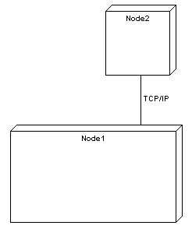
DEPLOYMENT DIAGRAMS
Deployment diagram
  Contains nodes and connections
  A node usually represent a piece of hardware in the system
  A connection depicts the communication path used by the hardware to communicate
  Usually indicates the method such as TCP/IP

Slide 32
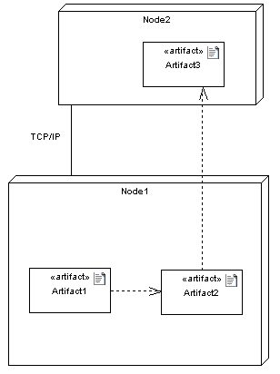
DEPLOYMENT DIAGRAMS
Deployment diagrams contain artifact
An artifact
  Artifacts represent concrete elements in the physical world that are the result of a development process and are deployed on nodes.
  Is the specification of a phisycal piece of information
  Ex: source files, binary executable files, table in a database system,….
  An artifact defined by the user represents a concrete element in the physical world

Slide 33
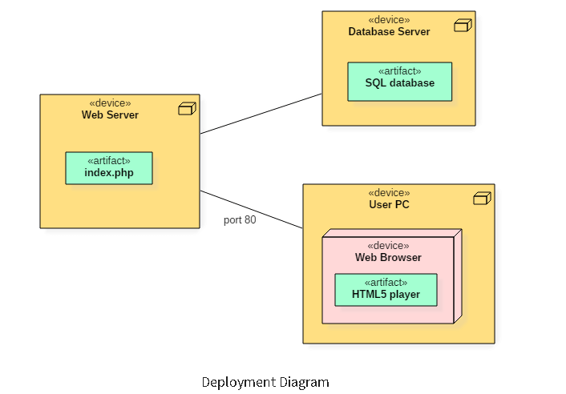
working of HTML5 video player in the browser

Slide 34
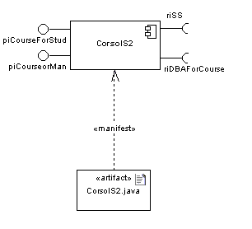
DEPLOYMENT DIAGRAMS
An artifact manifest one or more model elements
A <<manifestation>> is the concrete physical of one or more model elements by an artifact
This model element often is a component
A manifestation is notated as a dashed line with an open arrow-head labeled with the keyword <<manifest>>

Slide 35
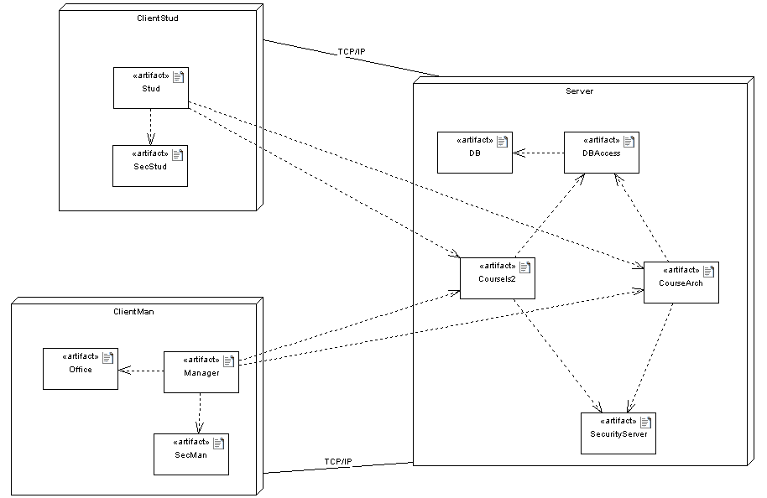
DEPLOYMENT DIAGRAMS

Slide 36
REFERENCIES
UML 2.0 Superstructure Specification
August 2, 2003
UML 2 Superstructure Final Adopted Specification
www.omg.org/cgi-bin/doc?ptc/2003-08-02
The Diagrams of UML 2.0
by Scott W. Ambler, 2003-2004
www.agilemodeling.com/essays/umlDiagrams.htm
UML overview
By Mandar Chitnis, Pravin Tiwari, & Lakshmi Ananthamurthy
http://www.developer.com/design/article.php/1553851

